Slide 1


Progetto di Ingegneria Gestione ed Evoluzione del Software
Top Manager
Andrea De Lucia
Project Manager
Francesco Vicidomini
Ferdinando D’Avino
Notes:
Ferdinando

Slide 2
Presentation Index
EVALUATIONS
PROJECT EVOLUTION
RISK
TEAM BUILDING
Notes:
Ferdinando

Slide 3




TEAM BUILDING
Selection criteria
Welcome
Objectively disintermediate leveraged manufactured products before team driven resources.
Soft skills
Avaiability
Women
Man
Skills
8%
92%
Objectively disintermediate leveraged manufactured products before team driven resources.
Teamwork propensity
Notes:
Ciccio

Slide 4




TEAM BUILDING
Tools
Notes:
Ciccio

Slide 5

RISK
Risk
Lack of Skills
Lack of Communication
Lack of Responsability
Notes:
Ferdinando

Slide 6
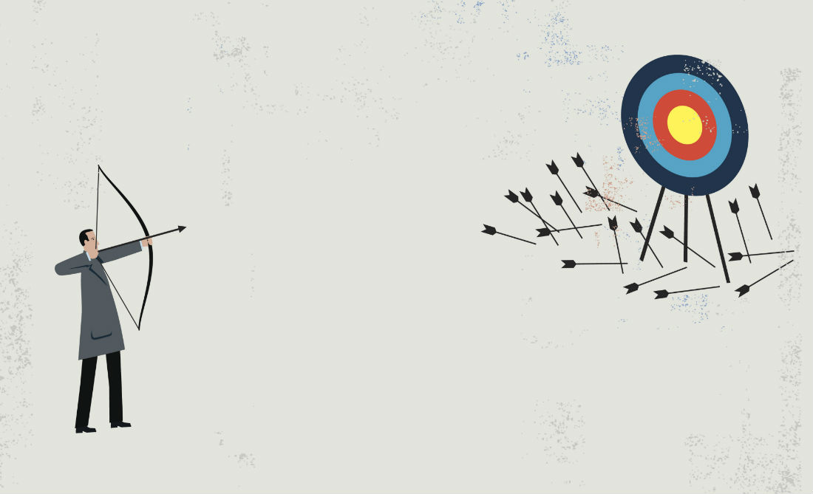

RISK
Lack of Skills
Objectively disintermediate leveraged manufactured products before team driven resources. Energistically incentivize holistic channels rather than interactive interfaces. Progressively productivate compelling innovation rather than functional content. Phosfluorescently strategize accurate web services rather than revolutionary bandwidth. Competently customize out-of-the-box leadership for client-based models.
Notes:
Ciccio

Slide 7

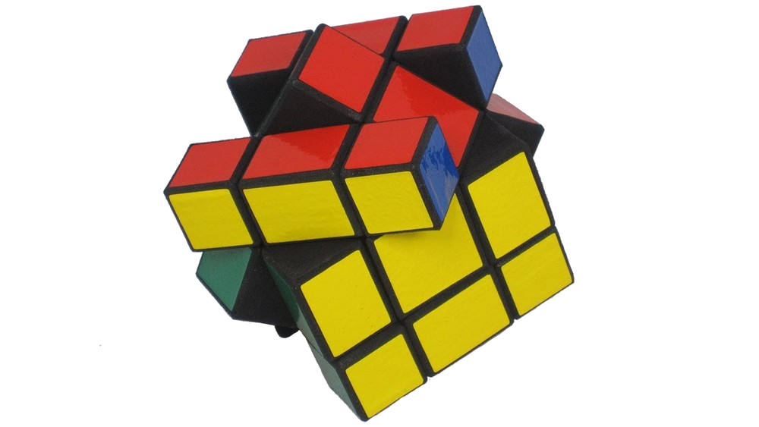
RISK
Lack of Communication
Notes:
Ciccio

Slide 8
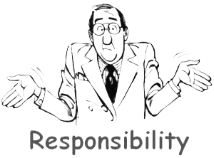
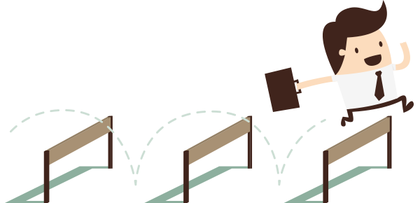
RISK
Lack of responsability
Notes:
Ferdinando

Slide 9

PROJECT EVOLUTION
Documents
220 RAD Pages
48 RF & 54 UC
100 % implemented
Notes:
Ciccio

Slide 10



PROJECT EVOLUTION
Dev Tools
NET BEANS
APACHE TOMCAT
PM Evaluation
PM Evaluation
TM Evaluation
TM Evaluation
EvoCinema
10
Notes:
Ferdinando

Slide 11


PROJECT EVOLUTION
Versioning Tool
Git Client
SOURCE TREE
GITKRAKEN
PM Evaluation
PM Evaluation
TM Evaluation
TM Evaluation
EvoCinema
11
Notes:
Ferdinando

Slide 12
PROJECT EVOLUTION
Insights
Giuseppe del Gaudio
Michele Delli Paoli
Luca Strefezza
55
48
40
Top Committer
4 branches
Total line of code
368959
466 commit
Notes:
Ciccio

Slide 13
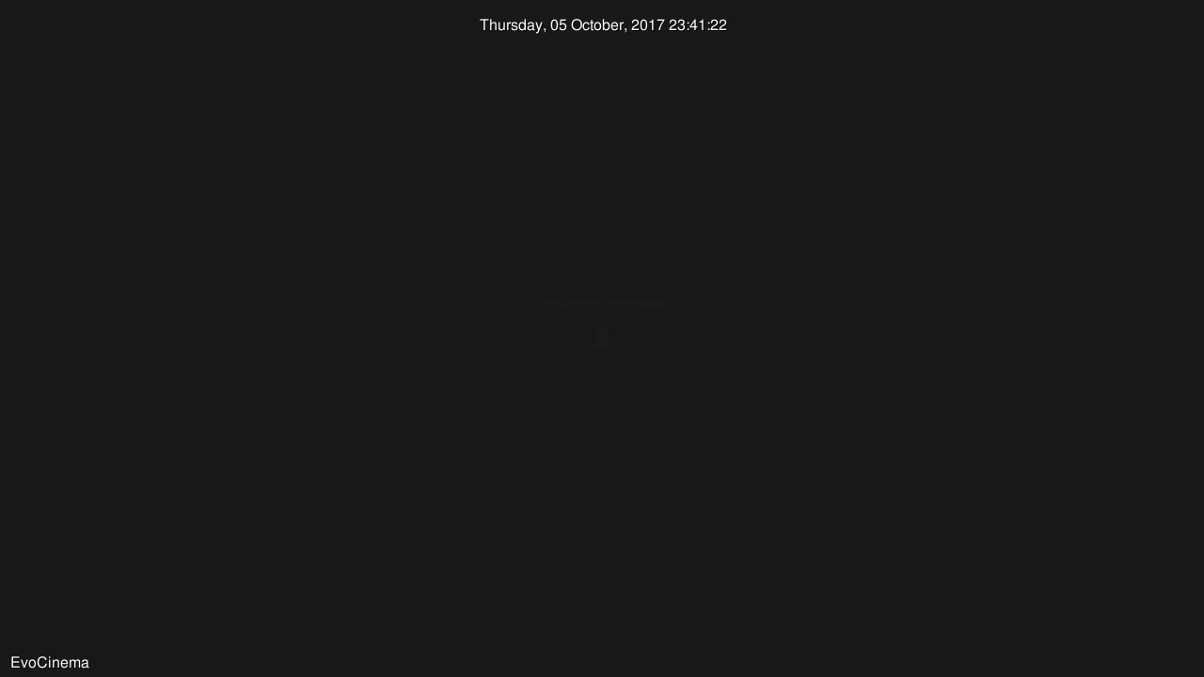
Full Image Options
Image And Content.
Objectively disintermediate leveraged manufactured products before team driven resources. Energistically incentivize holistic channels rather than interactive interfaces. Objectively disintermediate leveraged manufactured products.
Notes:
Ciccio

Slide 14

PROJECT EVOLUTION
IMPACT ANALYSIS
Change request
Notes:
Ferdinando

Slide 15
PROJECT EVOLUTION
CHANGE REQUEST
Porting Web
Expand the range of users
Layout restyling
Update functionality
Add library management
Notes:
Ferdinando

Slide 16
PROJECT EVOLUTION
PORTING WEB
FROM
TO
Presentation
Presentation
Business
Storage
Business
Storage
Notes:
Ferdinando

Slide 17


PROJECT EVOLUTION
Expand the range of users
FROM
TO
Notes:
Ciccio

Slide 18
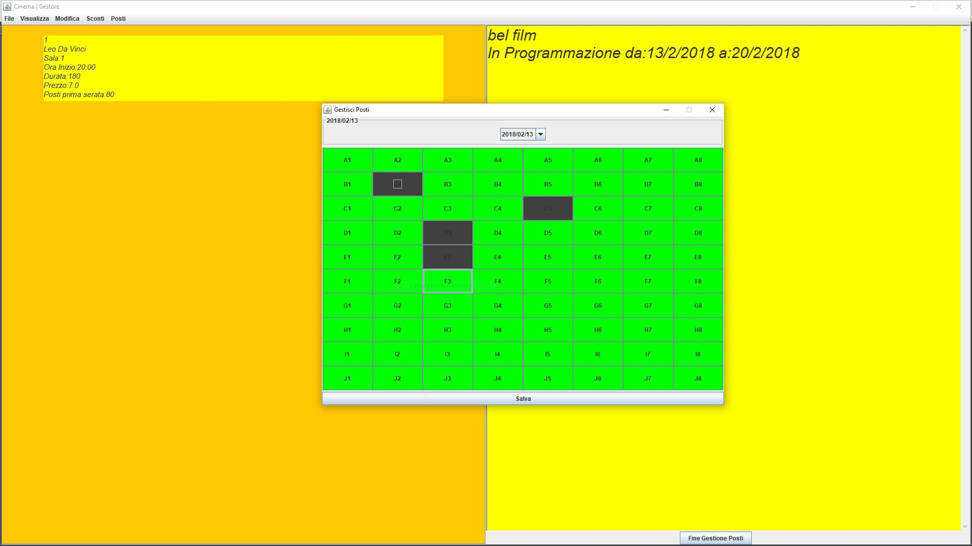
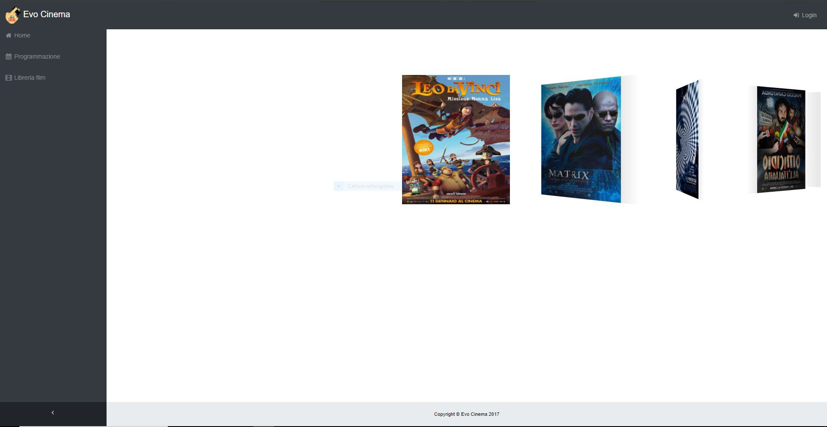
PROJECT EVOLUTION
Layout restyling
FROM
TO
Notes:
Ferdinando

Slide 19

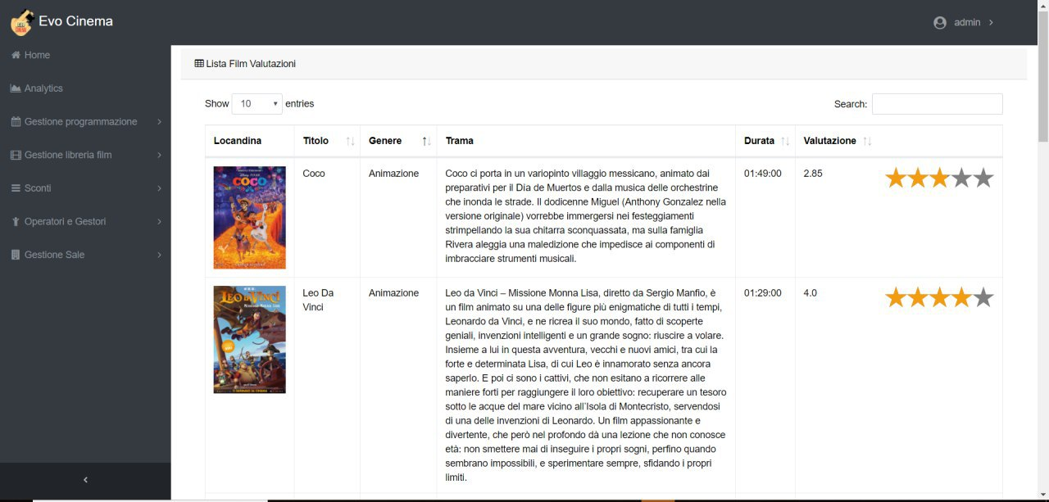
PROJECT EVOLUTION
Add library management
FROM
TO
Notes:
Ciccio

Slide 20

PROJECT EVOLUTION
IMPACT ANALYSIS
Change request
Impact analysis
Impact analysis
Notes:
Ciccio

Slide 21
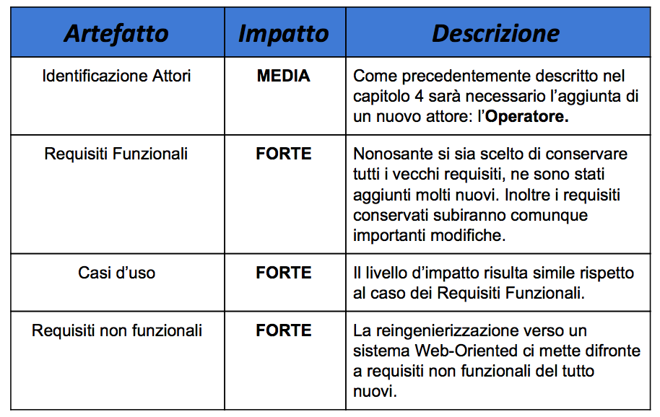
PROJECT EVOLUTION
Impact set
Notes:
Ciccio

Slide 22
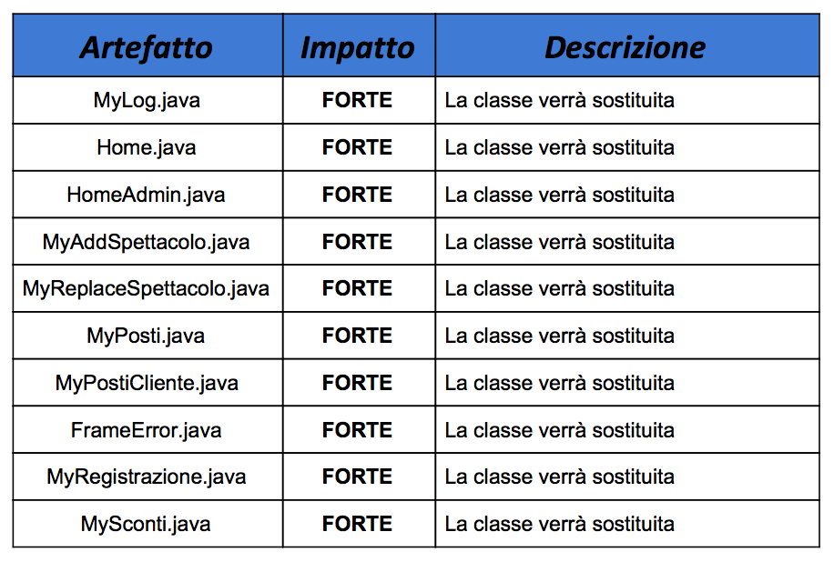
PROJECT EVOLUTION
Impact package “grafica”
Notes:
Ciccio

Slide 23
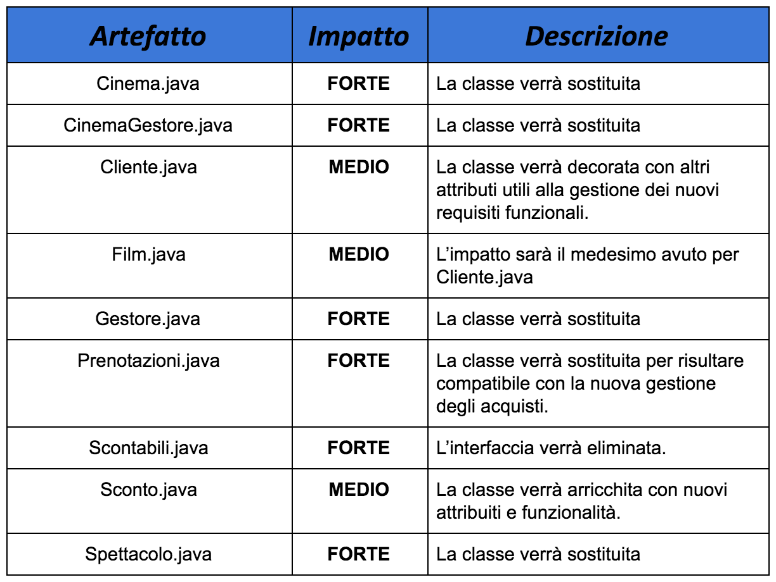
PROJECT EVOLUTION
Impact package “cinema”
Notes:
Ciccio

Slide 24
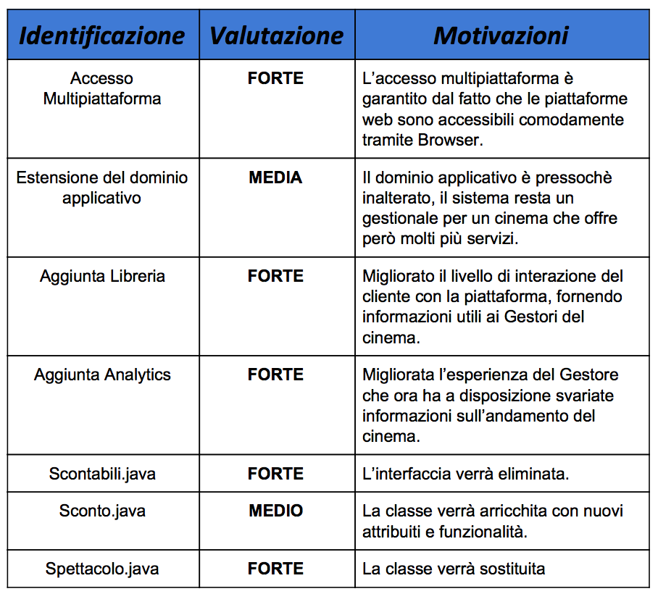
PROJECT EVOLUTION
Advantage
Notes:
Ciccio

Slide 25
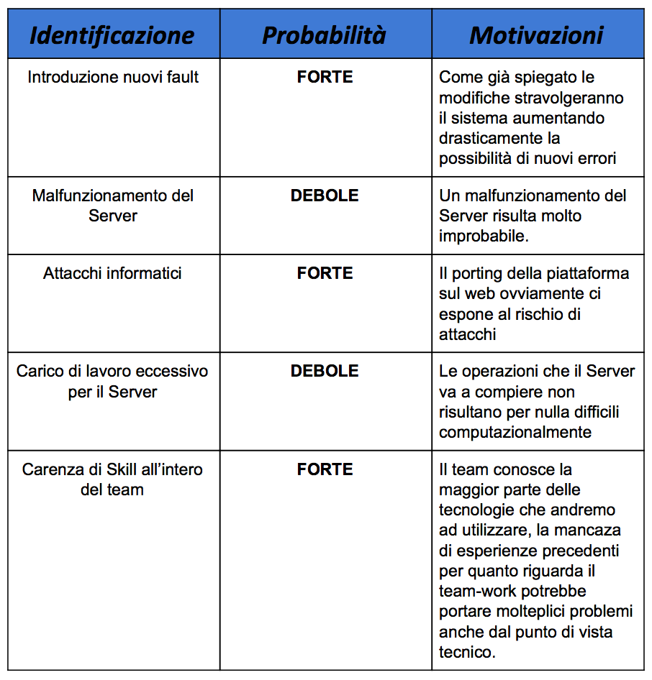
PROJECT EVOLUTION
Disadvantage
Notes:
Ciccio

Slide 26

EVALUATION
Notes:
Ciccio

Slide 27
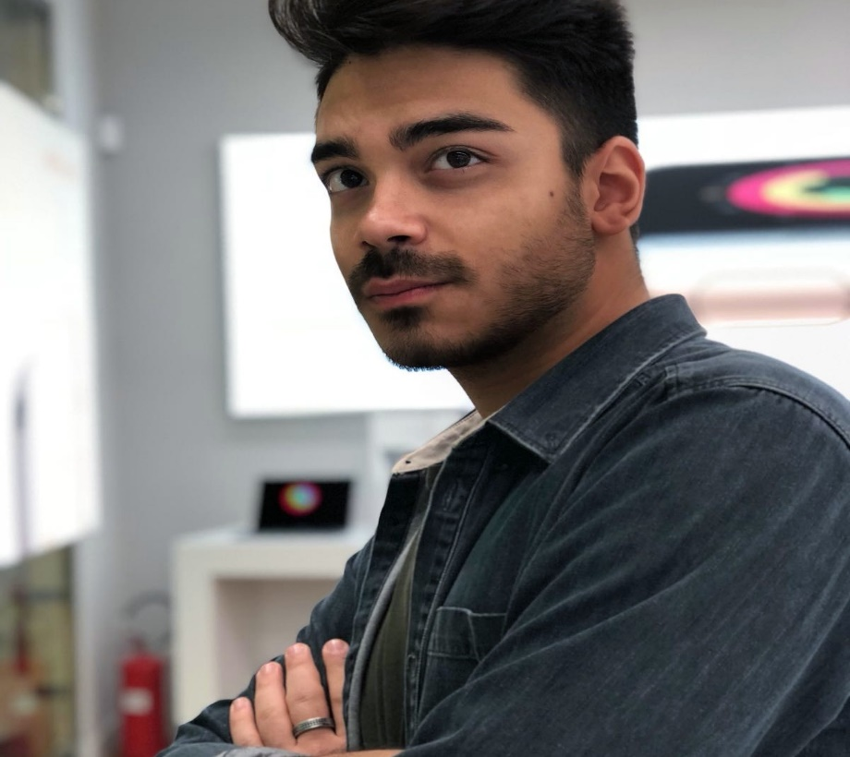
EVALUATION
Antonio Giulio
Pro
Proactivity
Contro
Willpower
Contro
Team Work
Implementation
Testing
Self-Evaluation: 10
TM-Evaluation: 8.1
3
FINAL EVALUATION
Notes:
Ciccio

Slide 28
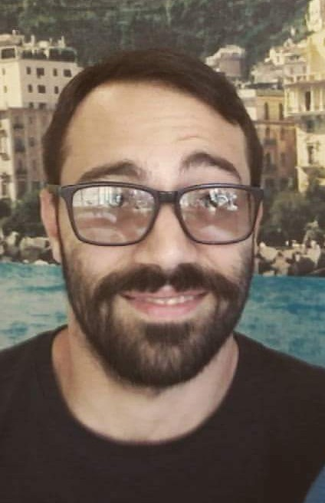
EVALUATION
Angelo Stefano D’Auria
Implementation
Pro
Contro
Slow Quality
Team Work
Moustache
Self-Evaluation: 9
TM-Evaluation: 8.3
3
FINAL EVALUATION
Notes:
Ferdinando

Slide 29
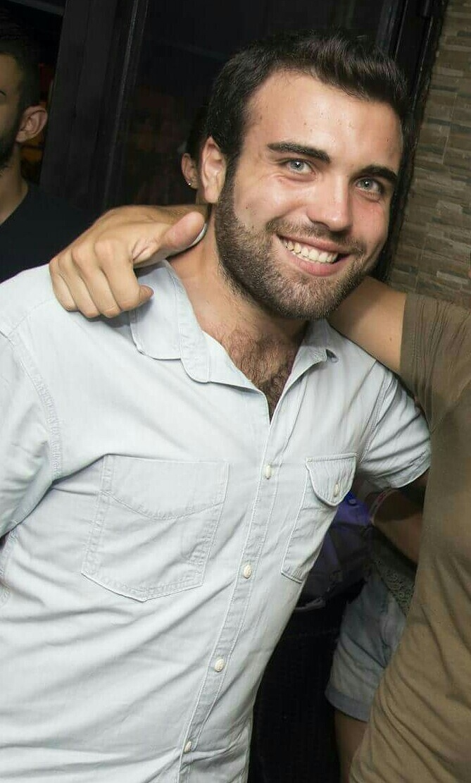
EVALUATION
Emanuele Buono
Willpower
Slow
Pro
Contro
Documentation
Implementation
Square
Self-Evaluation: 8
TM-Evaluation: 7.81
3
FINAL EVALUATION

Slide 30
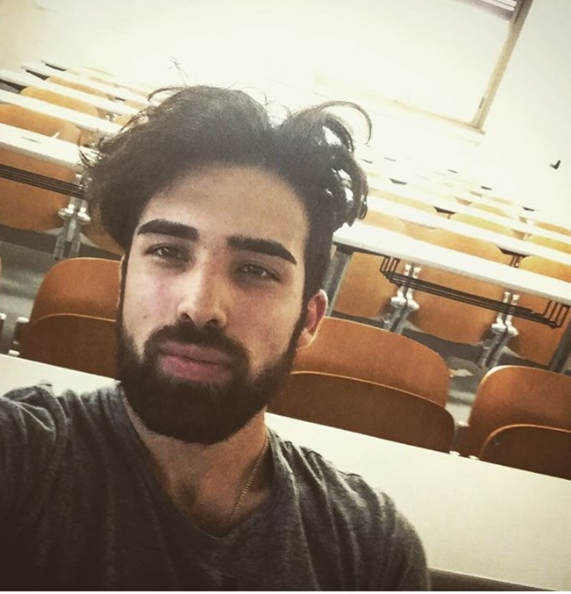
EVALUATION
Francesco De Feo
Proactivity
Avaiability
Pro
Contro
TeamWork
Lack of concentration
Self-Evaluation: 8
TM-Evaluation: 8.1
3
FINAL EVALUATION

Slide 31
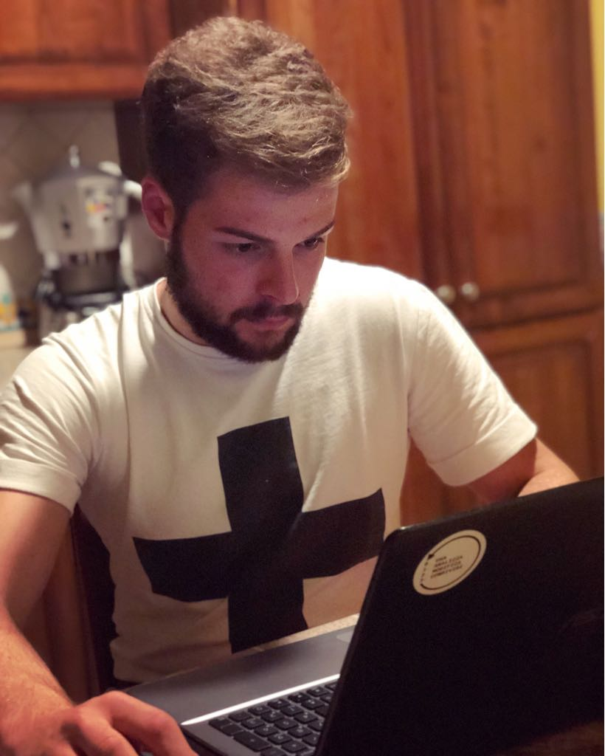
EVALUATION
Giuseppe Apuzzo
Implementation
Slow Quality
Pro
Contro
Willpower
Avaiability
Git Conflict
Self-Evaluation: 9
TM-Evaluation: 7.3
3
FINAL EVALUATION

Slide 32
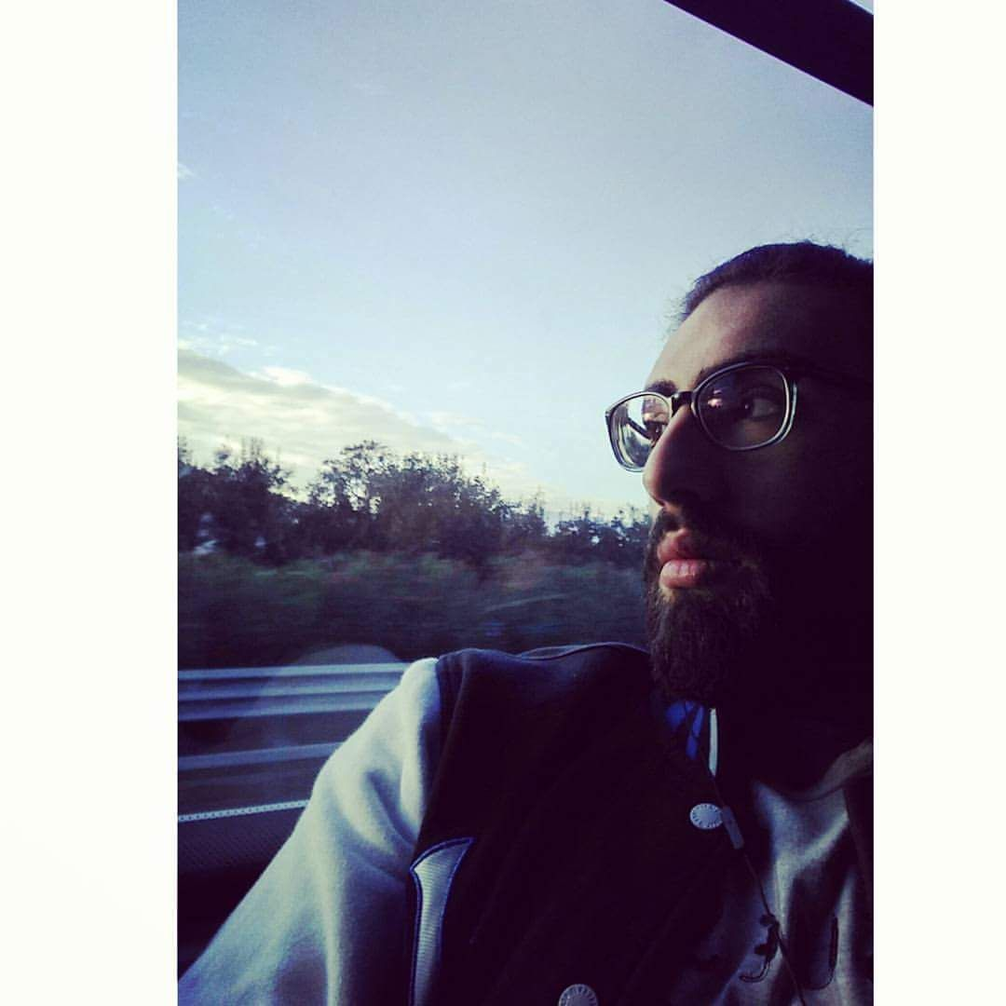
EVALUATION
Giuseppe D’Ambrosio
Documentation
Implementation
Pro
Contro
Proactivity
Avaiability
TeamWork
Self-Evaluation: 8
TM-Evaluation: 7.2
3
FINAL EVALUATION

Slide 33

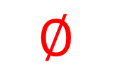
EVALUATION
Giuseppe Del Gaudio
Quality
Implementation
Pro
Contro
Willpower
$$∅$$
Documentation
Proactivity
Self-Evaluation: 6
TM-Evaluation: 9.3
4
FINAL EVALUATION

Slide 34
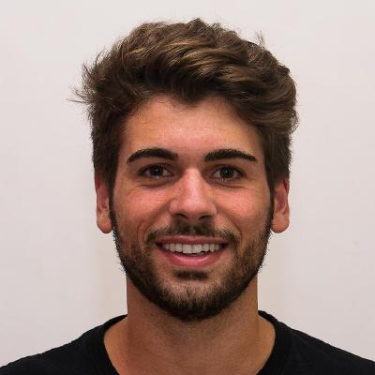
EVALUATION
Gianluca Villani
Quality
Pro
Contro
Documentation
Avaiability
Teamwork
Implementation
Self-Evaluation: 7
TM-Evaluation: 6.4
2
FINAL EVALUATION

Slide 35

EVALUATION
Luca Strefezza
Quality
Implementation
Pro
Contro
Willpower
Precision
Documentation
Proactivity
Self-Evaluation: 10
TM-Evaluation: 9.4
4
FINAL EVALUATION

Slide 36

EVALUATION
Michele Delli Paoli
Documentation
Avaiability
Pro
Contro
TeamWork
Quality
Self-Evaluation: 9
TM-Evaluation: 6.8
3
FINAL EVALUATION

Slide 37
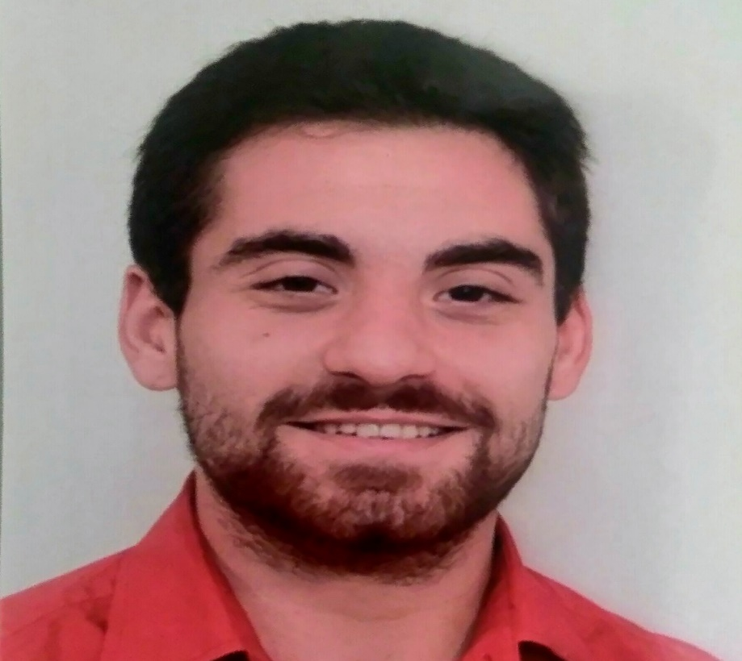
EVALUATION
Pietro Dell’Isola
Implementation
Pro
Proactivity
Willpower
Contro
Shy
Documentation
Self-Evaluation: 9
TM-Evaluation: 8.1
3
FINAL EVALUATION
Notes:
Timido = Shy

Slide 38
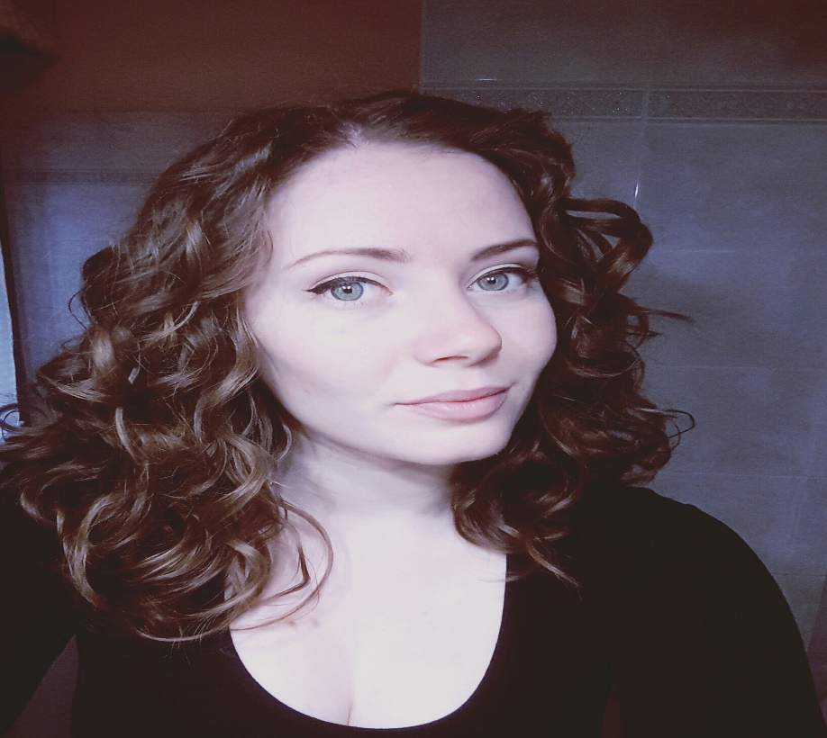
EVALUATION
Sara De Filippo
Avaiability
Testing
Pro
Willpower
Contro
Documentation
TeamWork
Implementation
Self-Evaluation: 9
TM-Evaluation: 7.5
3
FINAL EVALUATION

Slide 39
